Slide 1
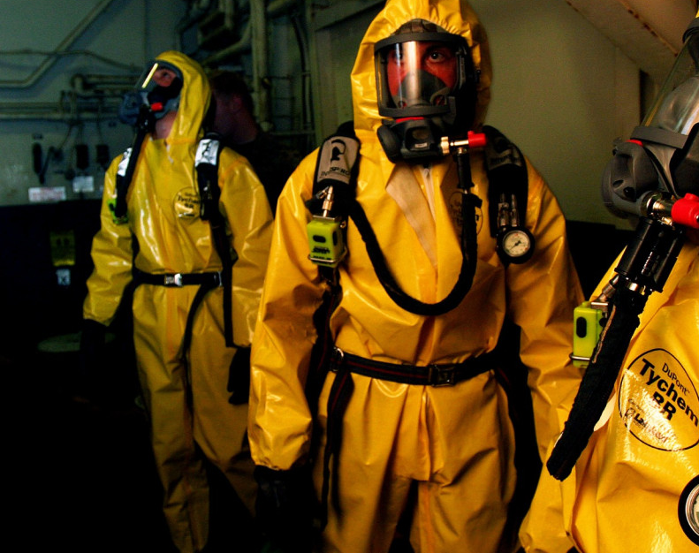
An Analysis of The Graniteville Train Crash
Group 1

Slide 2





The Antedote
infographics
Nitesh Maruthi
Harish Patlolla
Sai Teja
Sagi
Yasha Pastaria
Gopi Govindarajula

Slide 3




Outline
Background
Methods
Analysis
Conclusion
3

Slide 4
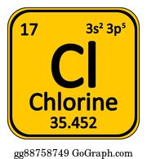




Background
1
Residents exposed to Chlorine gas
3
Economic cost of more than
$100M
profile
4
Identify chemicals exposed to, based on symptoms and reduce the symptoms
2
Several lives in danger, multiple injuries caused
Background
Methods
Results
Analysis
4

Slide 5


Data
Patient ID | Symptom1 | Symptom2
?
……Symptom79 | Chemical Name
Patient Data
1M records, 79 variables
Symptom1 | Symptom2 | …….Symptom79
Chemical Name
Chemical Data
311 records, 79 variables
Background
Methods
Results
Analysis
5

Slide 6

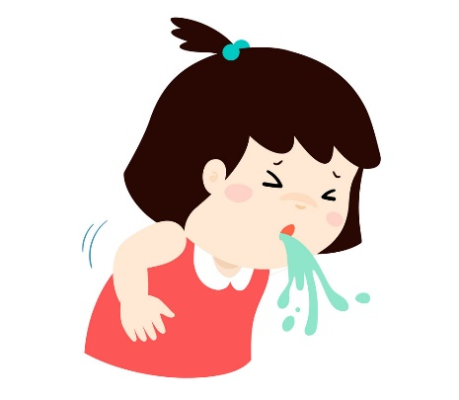
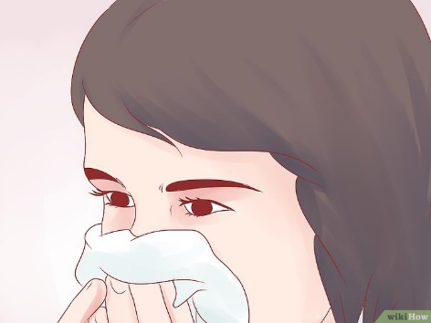


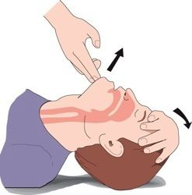
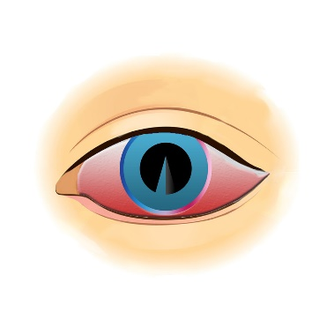

Most Common Symptoms
Affected 8.8M
people
Hearing Loss
Nasal Irritation
Vomiting
Tinnitus
profile
Eye Irritation Redness
Skin Burns
Shortness of Breath
Irregular Breathing
Background
Methods
Analysis
Results
6

Slide 7
Methods
1. Logic Creation
2. Methods to increase Computational Efficiency
Arrays
Patient | Chemical | AssignedScore
1 | 1 | 1
1 | 0 | -1
0 | 1 | 0
0 | 0 | 1
Use of Vectorized functions
Indexing
3. Generated
Similarity Scores
4. Picked Chemical with Highest Score
Background
Methods
Analysis
Results
7

Slide 8
Analysis
Patient ID | Symptom1 | Symptom2
1 | 1 | 0
2 | 1 | 0
3 | 0 | 1
. 1,000,000 | 1 | 1
……Symptom79 | Chemical Name
1 | Bromoform
1 | Aldrin
0 | Endosuplhane
0 | Acetaldehyde
profile
Background
Methods
Analysis
Results
8

Slide 9
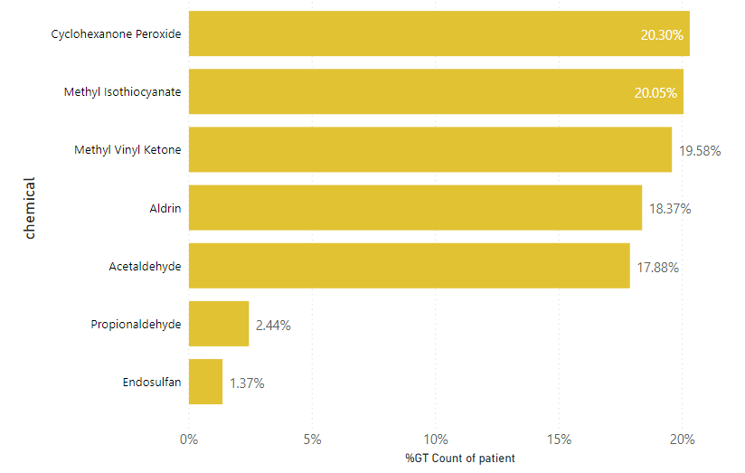
Analysis
95% people
profile
% of Patients Affected
Background
Methods
Analysis
Results
9

Slide 10
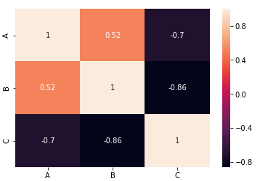
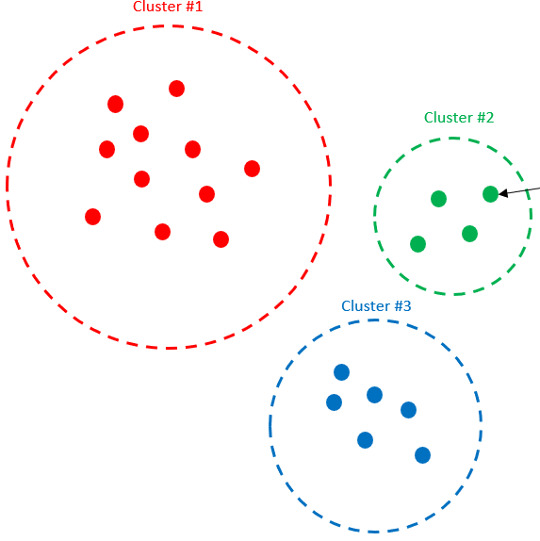
Analysis
2
1
2. Cramer’s V Correlation Coefficient
3. Variable Clustering
1.Under Sampling
3
Imbalanced Target
306 Chemicals
Chemical 1
5%
Chemical 2
Chemical 3
.
95%
profile
.
Chemical 311
5 Chemicals
Balanced Target
Removed variables with >0.7 correlation
26 symptoms
Background
Methods
Analysis
Results
10

Slide 11





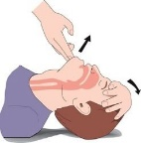


Results
1M Records
Sample 1
78%
26 symptoms
84% Accuracy
Sample 2
81%
Sample 3
83%
Deployment
..
profile
Sample n
Random Samples
Background
Methods
Analysis
Results
11

Slide 12
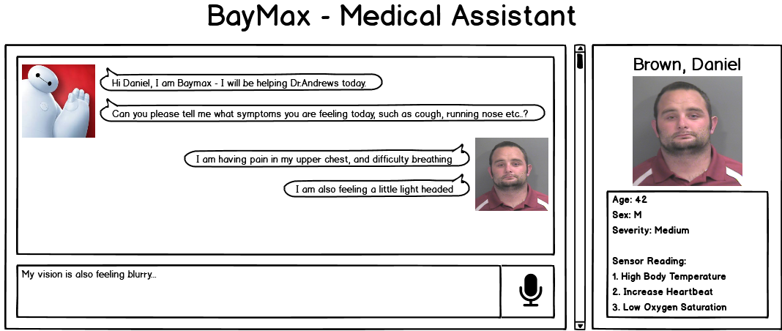
Our Solution
profile
Background
Methods
Analysis
Results
12

Slide 13
THANK YOU

Slide 14
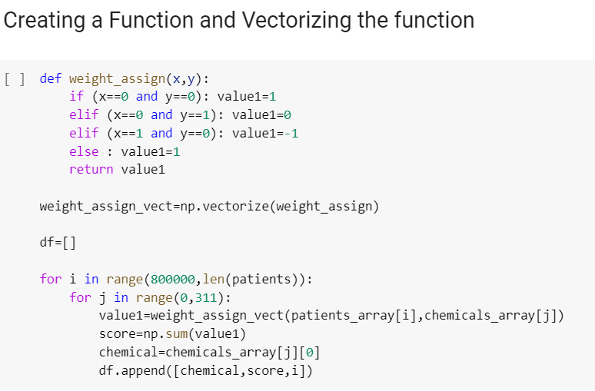
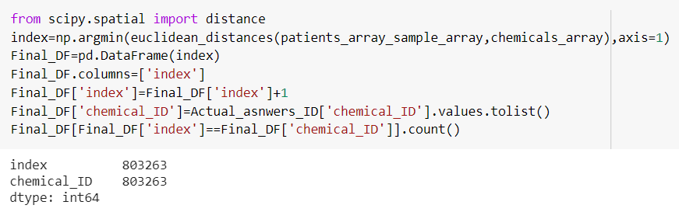
APPENDIX
Symptom | Patient count
Hearing loss | 889783
Eye irritation redness | 889385
Nasal irritation | 889375
Irregular breathing | 888862
Tinnitus | 888852
Shortness of breath | 888295
Skin redness | 888290
Vomiting | 888144
Skin burns burning | 887761

Slide 15
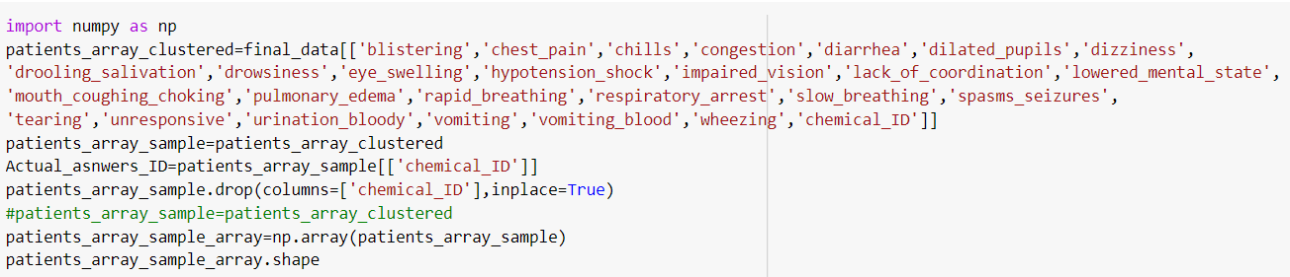
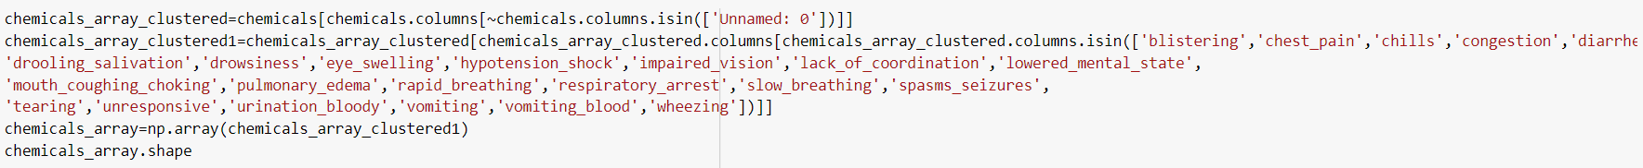
APPENDIX

